Slide 1
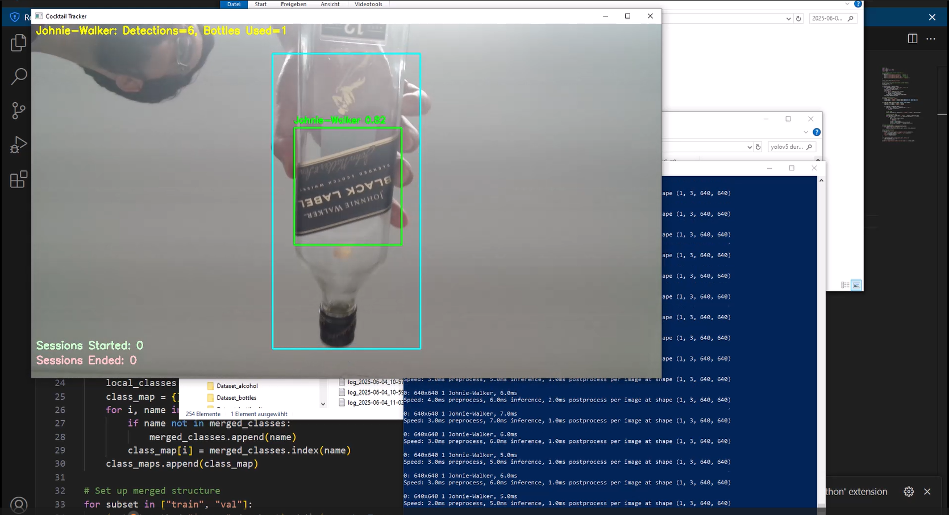
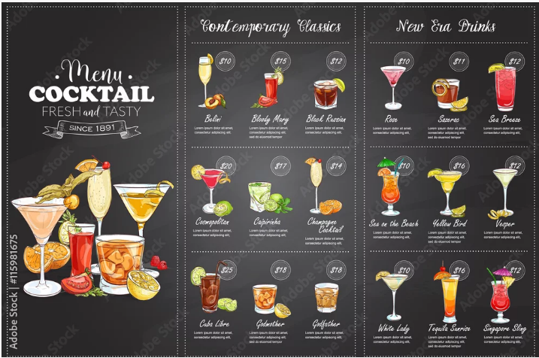
Business Intelligence II
Real Time Object Detection for Cocktail Bar Logging System—UNDEF-03

Slide 2
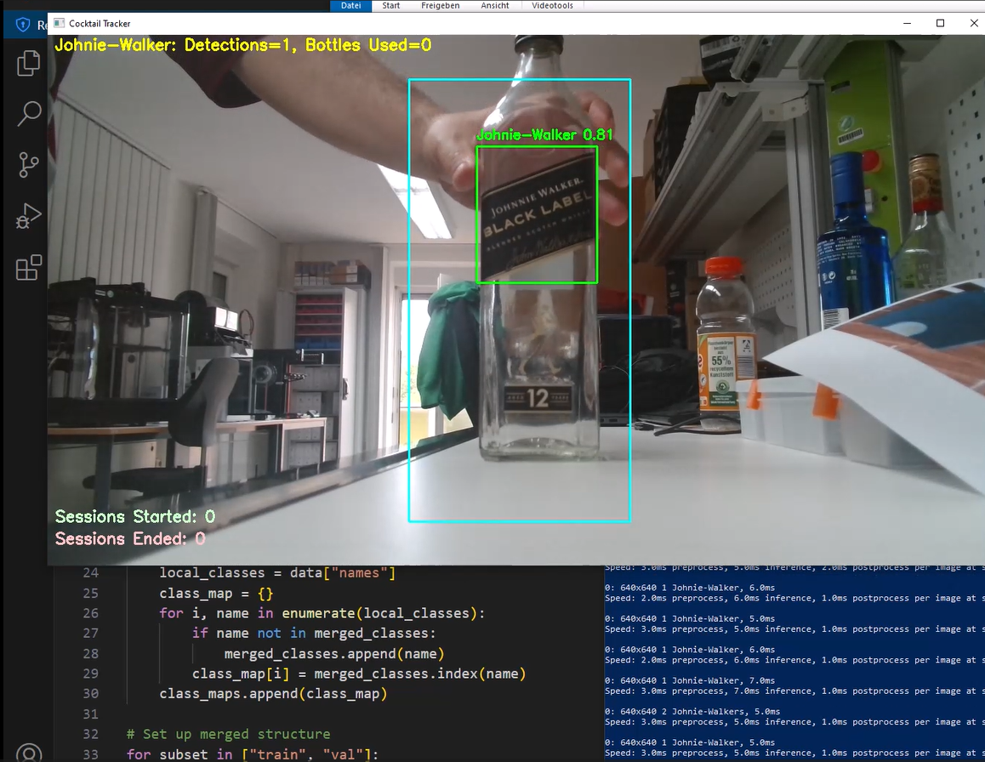
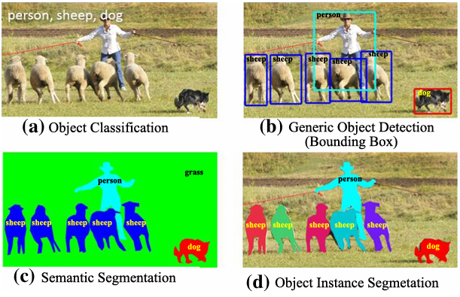
Project Description
Hands-on project aimed to develop a Deep Learning Model, that uses Real Time Object detection system for logging popular coktails on a bar setting. The system uses the YOLO algortihim (YOU ONLY LOOK ONCE) version 8 or V8.

Slide 3
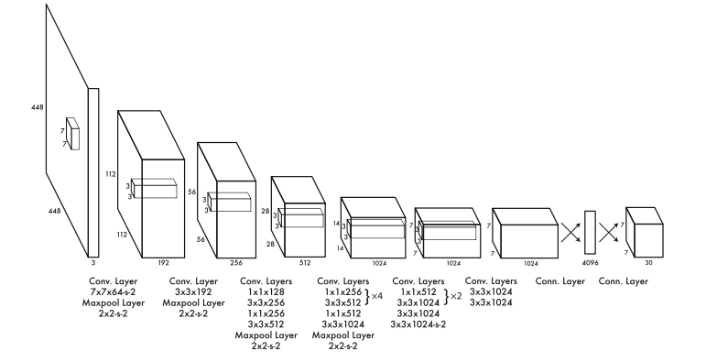
Core Concepts
Deep Learning: Branch of branch of artificial intelligence that uses layered neural networks to learn from large amounts of data, enabling systems to automatically recognize complex patterns.
Real Time Object Detection: This technology allows computers to instantly detect and locate objects within a live video stream. It’s especially useful in fast-paced environments where quick decisions are needed.
YOLOv8: Cutting-edge object detection model known for combining high accuracy with real-time performance. It was selected for this project because it works well with small and overlapping objects.

Slide 4
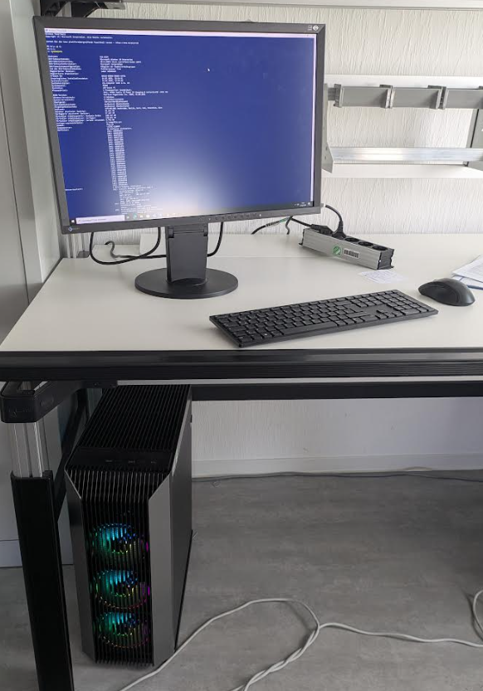
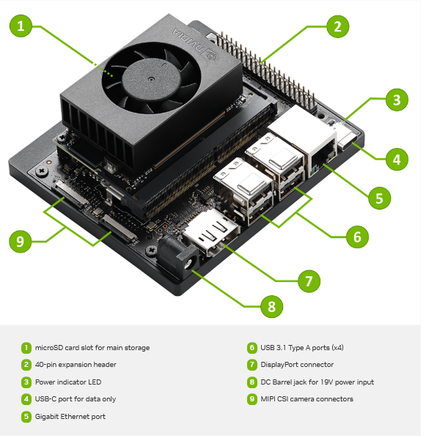
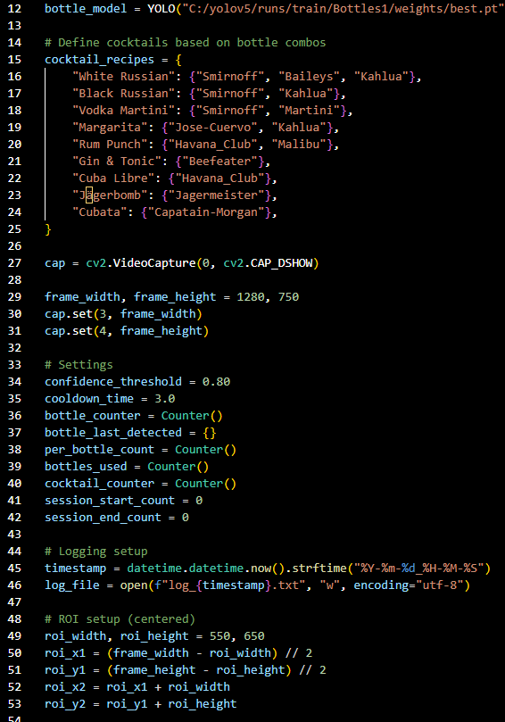
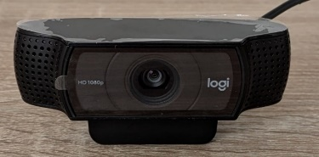
System Components and Devices
Software: Low assemble Python script.
Hardware: PC Desktop AMD Ryzen 9, NVIDIA Jetson Orin Nano, Logi HD 1080p USB-Camera

Slide 5
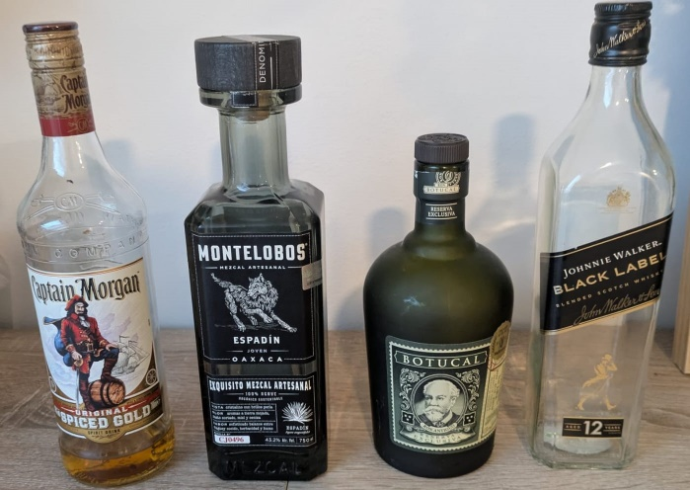
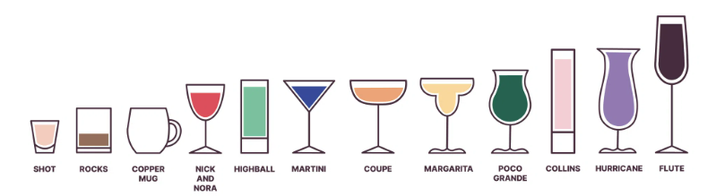
Problems and Challenges
Bottle Attributes: Shape, state, brand, type, color, cap.
Cocktail Attributes: Glass type, state, color, garnishes.
Deep Learning training requirements: Properly labelled images, image quality and quantity, structure organization, computing power.
Deployment Issues: Envioremental objects, latency, false positives.
The system is an assitent tool for the user rather than an entire automated framework. The user must get familiar with ist inner workings and monitor the results.

Slide 6
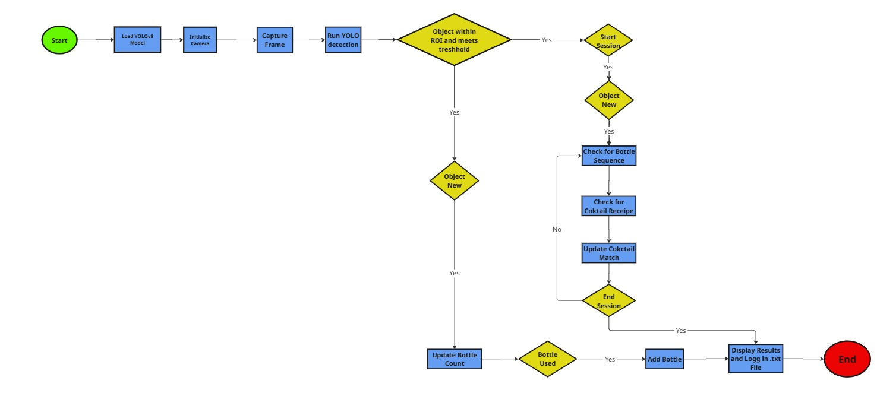
System Functioning

Slide 7
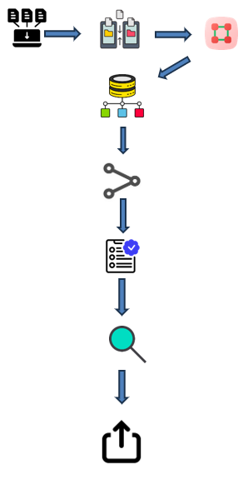
Pipeline
1. Image gathering
2. Structural organization (train and val files are necessary, while test is optional
3. Labelling
4. Classification of labels with images (for each image file a label .txt file is required)
5. Training of the model
6. Validation of results with training metrics
7. Detection test
8. Formatting of results for export

Slide 8
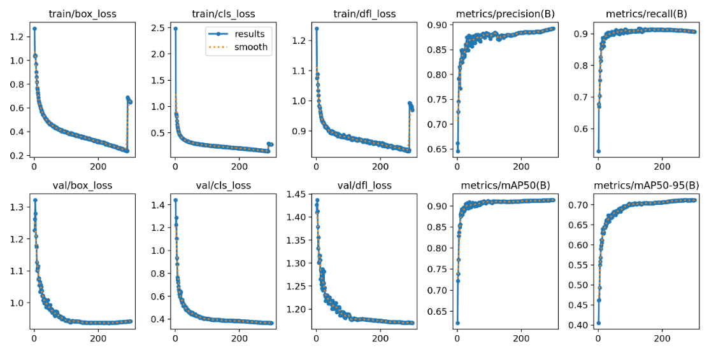
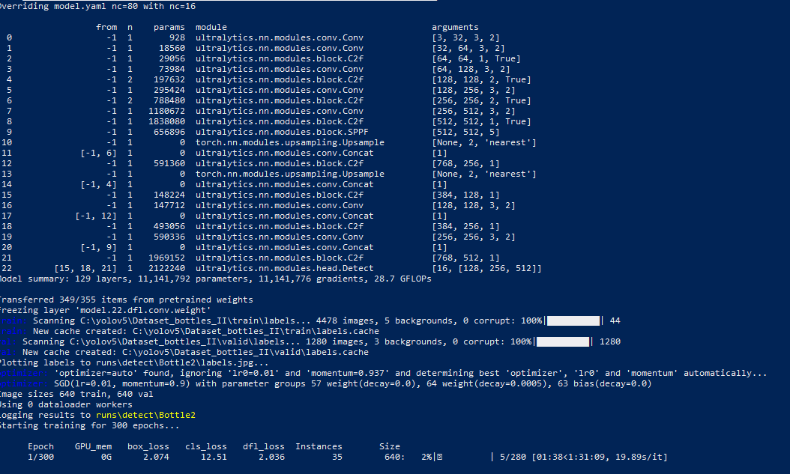
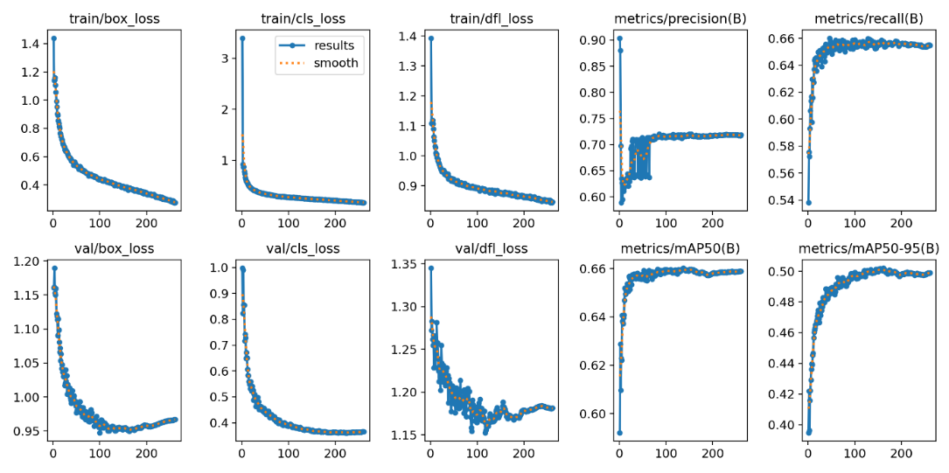
Training Process
Training Commands
yolo detect train model=yolov8s.pt data=C:/yolov5/Dataset_bottles_I/data.yaml epochs=300 imgsz=640 batch=16 name= Bottle1
yolo detect train model=yolov8s.pt data=C:/yolov5/Dataset_bottles_I/data.yaml epochs=300 imgsz=640 batch=16 name= Bottle1

Slide 9
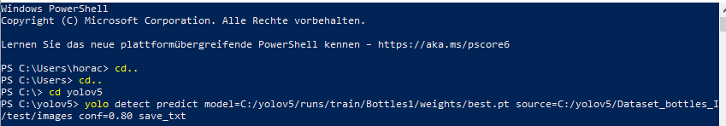
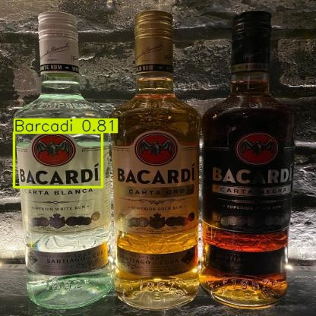
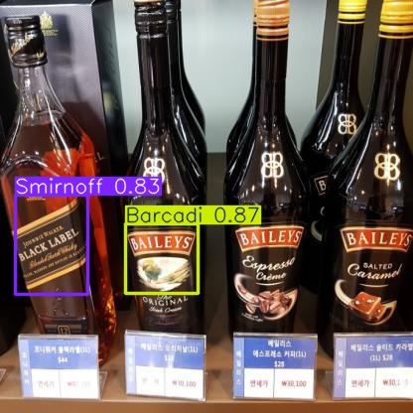
Testing First Stage
Command Test

Slide 10
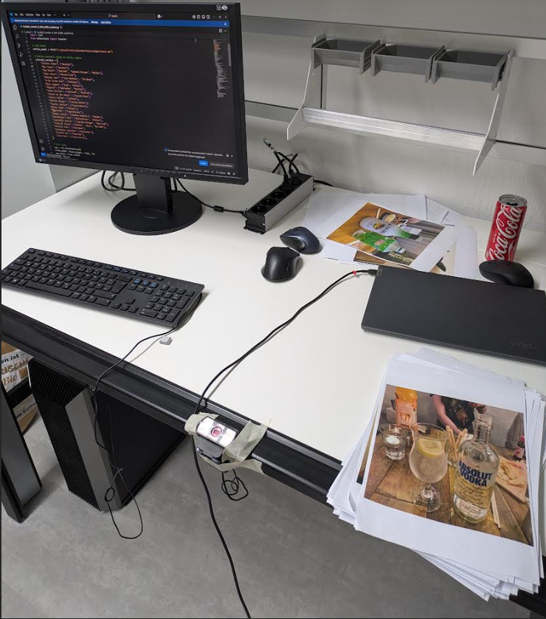
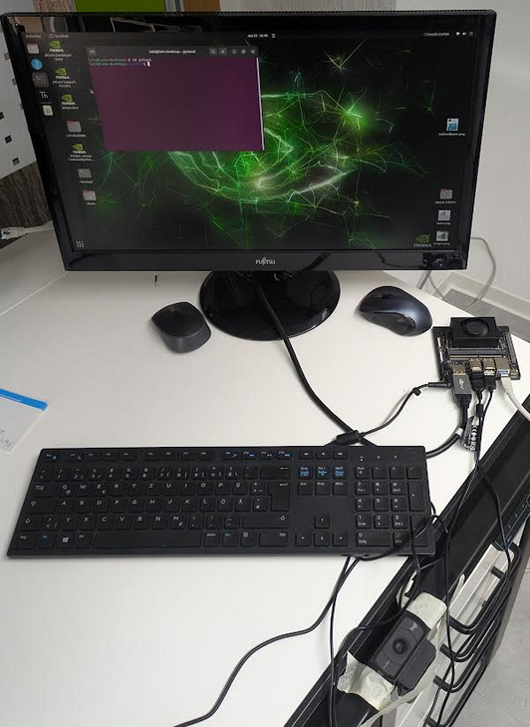
Testing Second and Third Stage
Simple Test
Advanced Test
Desktop – Command lines – Training
Windows – Power Shell – best.pt
NVIDIA Jetson Orin Nano – USB Camera
Linux – Terminal – best.onnx

Slide 11
Results
Model I
Precision: 91.1%
Recall: 82.8%
mAP@0.5: 87.1%
Real-time detection accuracy (printed images): ~90%
Issues: Struggled with misclassifying similar labels (e.g., Absolut vs. Smirnoff), and affected by latency in real-time use.
Model II
Precision: 65.9%
Recall: 62.2%
mAP@0.5: 64.1%
Real-time detection accuracy (printed images): ~93%
Strength: Performed better in real-world tests due to more diverse training data.
Advanced Deployment (Jetson Orin Nano)
Detection rates dropped due to latency: Model I (~80%), Model II (~89%)
Cocktail preparation accurate for simple recipes, but limited for complex mixes due to label confusion and latency.

Slide 12
Conclusion
The project successfully delivered a low-cost, real-time object detection system using YOLOv8 to log cocktail preparation based on bottle recognition.
While Model I had better training metrics, Model II performed more reliably in real-world settings. The system proved useful for inventory tracking and customer preference insights, especially in bars and similar environments.
Limitations include:
Sensitivity to latency
Misclassification of visually similar bottles
Reliance on user understanding for optimal use
The framework is scalable, adaptable, and ready for further development, especially with improved data and retraining.

Slide 13
Sources
Bochkovskiy, A., Wang, C.Y. and Liao, H.Y.M., 2020. YOLOv4: Optimal Speed and Accuracy of Object Detection. arXiv preprint arXiv:2004.10934. [online] Available at: https://arxiv.org/abs/2004.10934 [Accessed 27 Jun. 2025].
Brownlee, J., 2019. A Gentle Introduction to Object Recognition With Deep Learning. [online] Machine Learning Mastery. Available at: https://machinelearningmastery.com/object-recognition-with-deep-learning/ [Accessed 27 Jun. 2025].
Goodfellow, I., Bengio, Y. and Courville, A., 2016. Deep Learning. Cambridge, MA: MIT Press.
Jocher, G., Chaurasia, A., Qiu, J. and Stoken, A., 2023. YOLOv8: Ultralytics official repository. [online] Available at: https://github.com/ultralytics/ultralytics [Accessed 27 Jun. 2025].
LeCun, Y., Bengio, Y. and Hinton, G., 2015. Deep learning. Nature, 521(7553), pp.436–444. https://doi.org/10.1038/nature14539
NVIDIA, 2023. Jetson Orin Nano Developer Kit - Get Started Guide. [online] Available at: https://developer.nvidia.com/embedded/learn/get-started-jetson-orin-nano-devkit [Accessed 27 Jun. 2025].
OpenCV, 2024. Open Source Computer Vision Library. [online] Available at: https://opencv.org/ [Accessed 27 Jun. 2025].
Paszke, A., Gross, S., Massa, F., Lerer, A., Bradbury, J., Chanan, G., Killeen, T., Lin, Z., Gimelshein, N., Antiga, L., Desmaison, A., Kopf, A., Yang, E., DeVito, Z., Raison, M., Tejani, A., Chilamkurthy, S., Steiner, B., Fang, L., Bai, J. and Chintala, S., 2019. PyTorch: An Imperative Style, High-Performance Deep Learning Library. In: Advances in Neural Information Processing Systems, 32, pp.8024–8035. Available at: https://papers.nips.cc/paper_files/paper/2019/hash/bdbca288fee7f92f2bfa9f7012727740-Abstract.html [Accessed 27 Jun. 2025].
Zhang, Z., 2019. A Review on Evaluation Metrics for Object Detection Algorithms. arXiv preprint arXiv:2006.11835. [online] Available at: https://arxiv.org/abs/2006.11835 [Accessed 27 Jun. 2025].
Zhao, Z.Q., Zheng, P., Xu, S.T. and Wu, X., 2019. Object Detection with Deep Learning: A Review. IEEE Transactions on Neural Networks and Learning Systems, 30(11), pp.3212–3232. https://doi.org/10.1109/TNNLS.2018.2876865

Slide 14
Thank You

